Slide 1
Coca Cola <> Valiance Solutions
April 24, 2024

Slide 2
Data Sanity | Dispenser ID Waterfall - Pre & Post Data Cleanup
Base File
34979
Dispensers active on Jan 1, 23
34979
Trouble Add File
33049
98
33049
98
Work-order file
21838
162
13112
25934
253
~8% NAs
+
25% NAs
Work-Order Dispenser ID attribution increased to 93% from 63%.
Proportion of Work-Orders with NA dispenser ID reduced from 25% to 8% (22% Service Value to ~7%)
Proportion of work-orders with dispenser id also present in base file increased to 90% from 63%

Slide 3
Data Sanity | Error & Implemented Solution
Formatting Error in Work-Order File (18% records)
Eg. 9000-ZPL32265, 7000-ZSA30671, Z s a 320082, Z%L359615A
Fixed formatting through a series of logics to fix mis-matches between WO file and Base File
Dispenser ID missing in WO file (25% records)
Retrieved unique dispenser ID by matching outlet account number, platform, intro & disc. dates.
Found closest matching dispenser ID (60% threshold) for the same outlet account number in the base file
Replaced dispenser ID with a another dispenser ID associated with the outlet in the base file
No Match Found (8% records)
Couldn’t find any potential dispenser Id in base sheet.

Slide 4
Service Cost Estimation - Timeline Summary
Output Metric and its granularity
Service Cost/Dispenser
Service Cost/Dispenser
25th percentile cost bucket
Annual Service Cost/Dispenser
25th percentile cost bucket
Annual Service Cost/Dispenser
25th percentile cost bucket
Service Cost/Dispenser
30th percentile cost bucket
Service Cost/Dispenser
30th percentile cost bucket
Input Data
Static, Usage, and Maintenance
Static, Usage, and Maintenance
Static, Usage, and Maintenance
Static, Usage, and Maintenance
+
Trouble Add
Static, Usage, and Maintenance
+
Sensor Data
Static, Usage, and Maintenance
+
Sensor Data
+
Hours Spent (Output Metric)

Slide 5
Service Cost Estimation - Timeline Summary
Output Metric and its granularity
Hours Spent/Service
Service Reason
Daily Service Cost per active dispenser
Daily Service Cost per active dispenser
Input Data
Static, Usage, and Maintenance
+
Sensor Data
+
Service Reason
Static, Usage, and Maintenance
+
Sensor Data
Static, Usage, and Maintenance
+
Sensor Data
Static, Usage, and Maintenance
+
Sensor Data
+
Day of the Week

Slide 6
Model 1 | Estimating ‘per service’ cost using non-sensor data
Factors fed to the model
Questions we are trying to answer
City
Outlet
Dispenser Model
Avg. Volume Dispensed
Age of Dispenser
Time from Last Service
Month of Servicing
Is there something common between cities/outlets that have high servicing costs?
Is the servicing cost significantly impacted by the age & usage of dispenser?
Is the servicing cost related to time of the year or the last time the dispenser was serviced?
Static
Usage
Maintenance

Slide 7
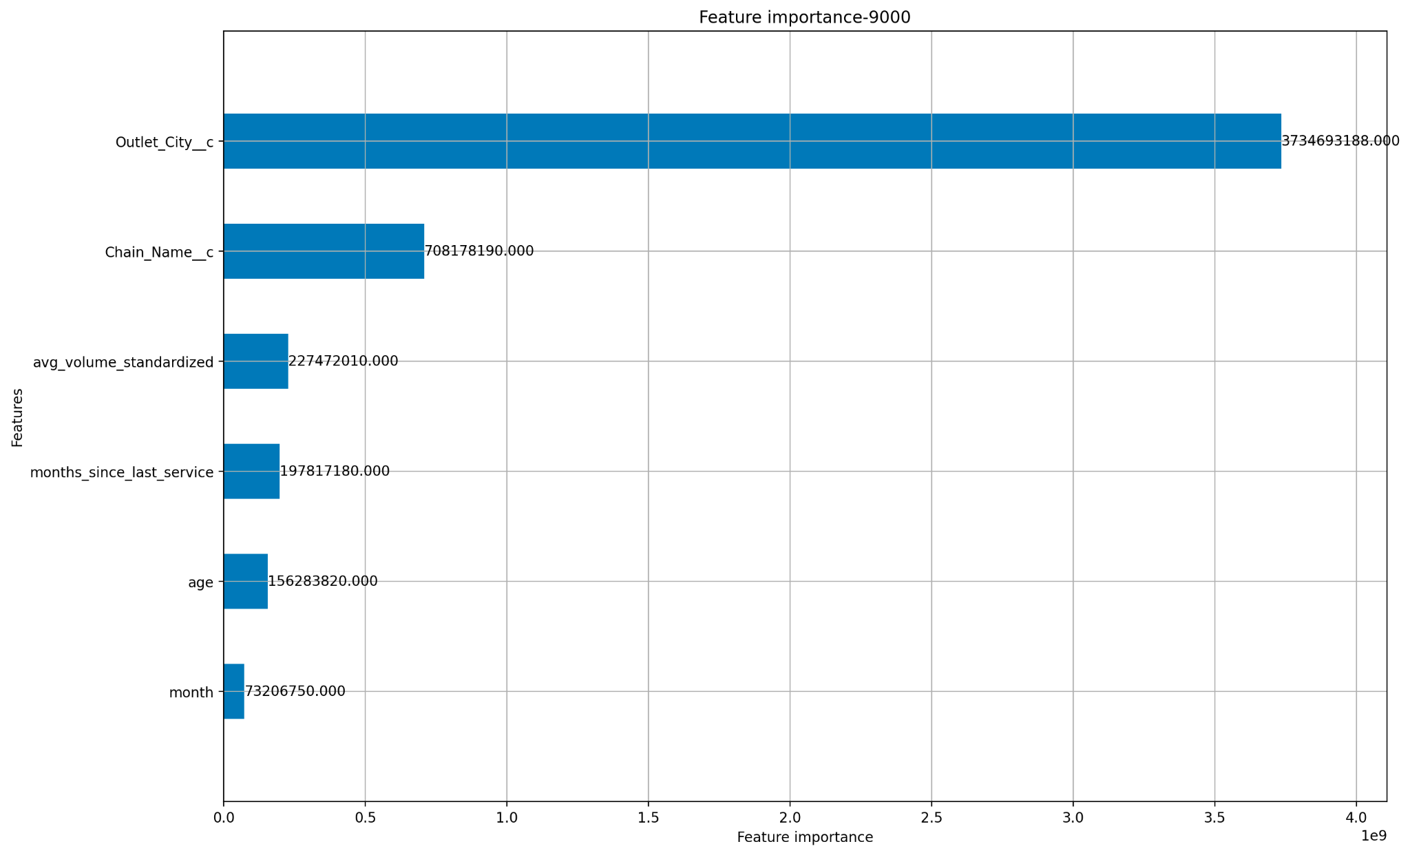
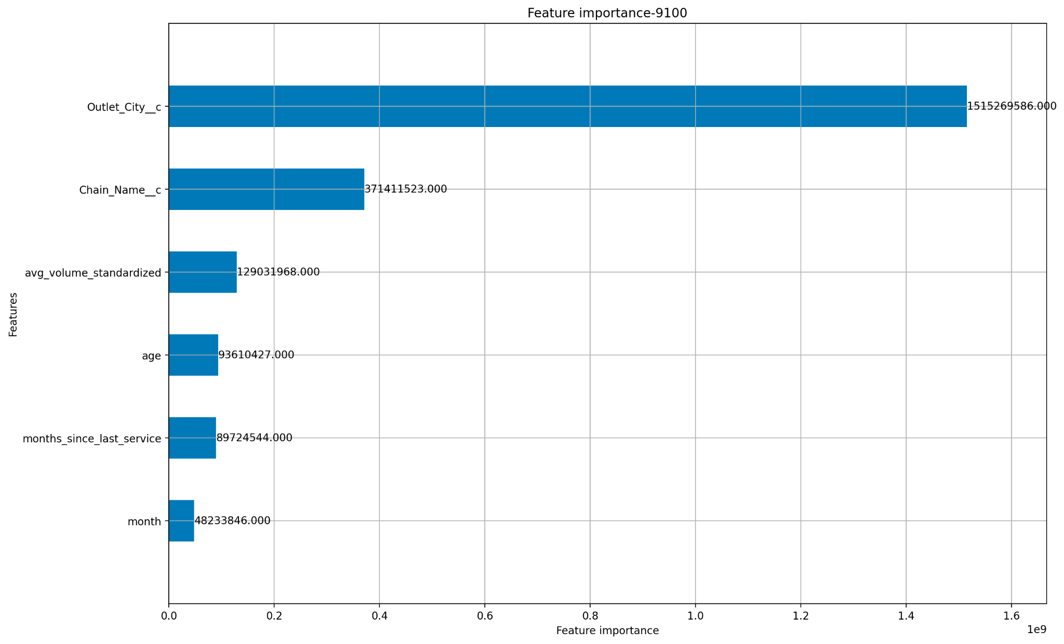
Model 1 | Low Accuracy but shows high sensitivity to City & Outlet
The error in the model was $350. However the the standard deviation of the models itself was $370. Therefore we can infer that the model has not been able to learn much about estimating cost at a per service level
Service Costs are far more correlated with static factors as compared to usage or maintenance patterns. (* Low confidence)

Slide 8
Model 1 | Little to no correlation between top states/cities/outlets
States
City
Top 10 High Service Cost Outlets
>$350
>$2000
Hawaii
New York
Maine
Vermont
Antelope
Red Bluff
Early
Zion
Rego Park
Plex
Jones Bros Cupcakes
El Meson Of Fl
Conico Management
United Supermarket Llc
Taco Time International
Swankys Taco Shop
42 North
Nemacolin Woodlands
Boyne Usa Resorts
Papa Joes Dmc
High Cost
<$250
<$100
Wyoming
Iowa
Louisiana
Alabama
Iowa
Scottsburg
Frostburg
Maize
Aubrey
Low Cost

Slide 9
Model 1 | High cost outlets incur similar costs in all states
What do we infer?
There are factors that make the outlet of a brand in one city/state different from that in another city/state. Intuitively, these factors could be usage behaviour or climate, impact of which may be quantified through sensor data.
All Figures in $
States | Present In Top 5 States |  | Present in atleast 4 of top 5 states
 | Five Guys Enterprises Llc | Wendys International | Moes Southwest Grill Llc | Popeyes Louisiana Kitchen Inc
Maine | 213 | 276 | 276 | 216
New York | 519 | 305 | 367 | 517
Hawaii | 499 | 205 | 397 | Not Present
Vermont | 256 | 254 | 135 | 278
Rhode Island | 510 | 477 | Not Present | 283
Wyoming | 307 | 223 | Not Present | 207
Iowa | 438 | 458 | 384 | 353
Alabama | 812 | 439 | Not Present | 219
Louisiana | 412 | 263 | 308 | Not Present
Nebraska | Not Present | 274 | Not Present | Not Present

Slide 10
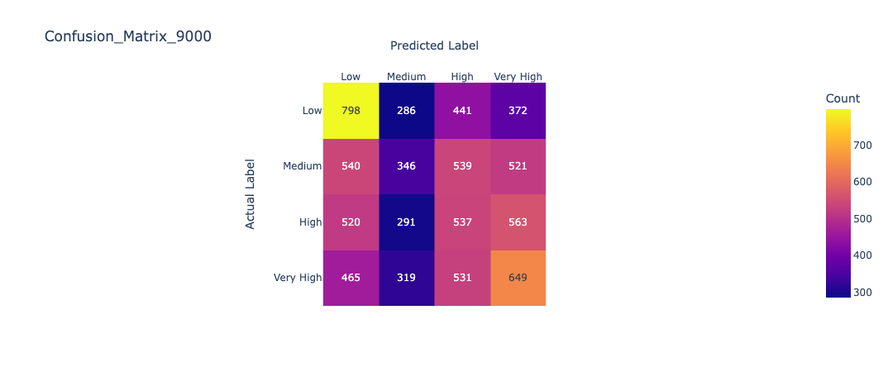
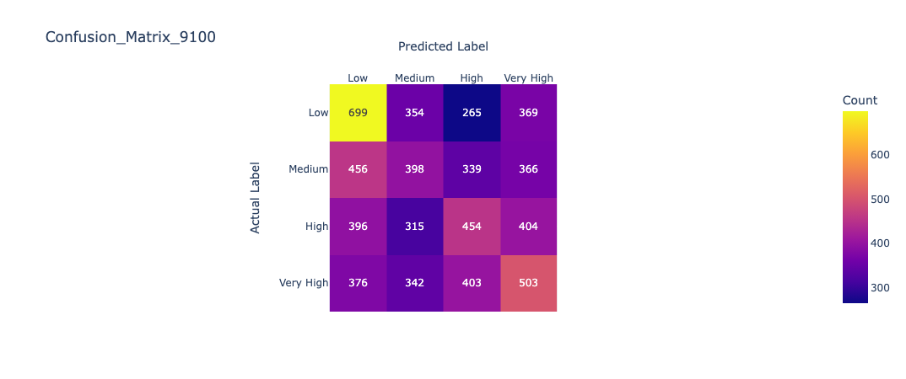
Model 1 | ~30% accuracy in predicting the 25th percentile cost bucket
Why predict at cost bucket level?
The model was unable to predict accurately at ‘per service cost’, therefore we tried to reduce the granularity and estimate the cost bucket. However, the model is able to predict the cost only with a 30% accuracy.
9000
9100
0 - $120
0 - $120
$120 - $220
$120 - $180
$220 - $450
$180 - $300
$450 - $7200
$300 - $5700

Slide 11
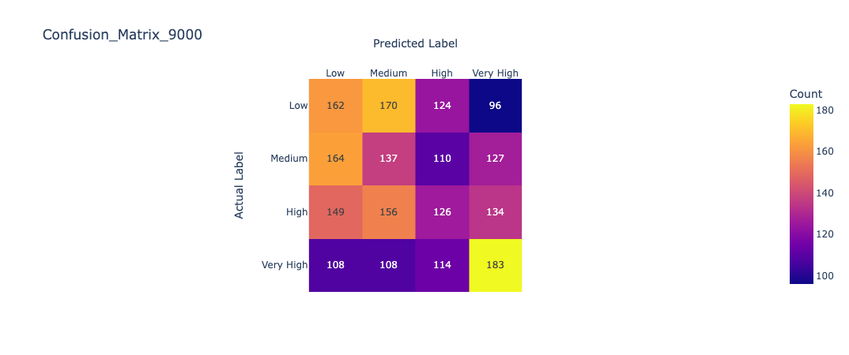
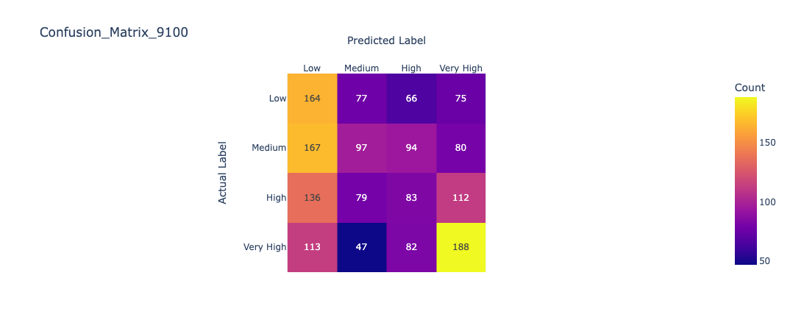
Model 1 | ~32% accuracy in predicting the annual service cost for a dispenser
Why predict annual cost?
The model was unable to predict accurately at ‘per service cost’ & ‘cost bucket’ level, therefore we tried to further reduce the granularity and estimate the annual cost. However, the model performance is no different. The accuracy to predict the top and bottom quartiles also lies within 35-40%.
9000
9100
0 - $450
0 - $350
$450 - $930
$350 - $730
$930 - $1700
$730 - $1350
$1700 - $10000
$1350 - $11000

Slide 12
Model 1 | Summary
The model is unable to predict the servicing cost for a dispenser - both per service cost or annual cost even at cost bucket level
The cities/states with higher per service cost seem to the one with higher number of dispensers installed. But at the same time, the volume dispensed has shows low correlation with service cost. This means that there are some other factors that we need to consider.
Next Steps - Model 2
To study sensor data and establish its relationship with the service cost of a dispenser

Slide 13
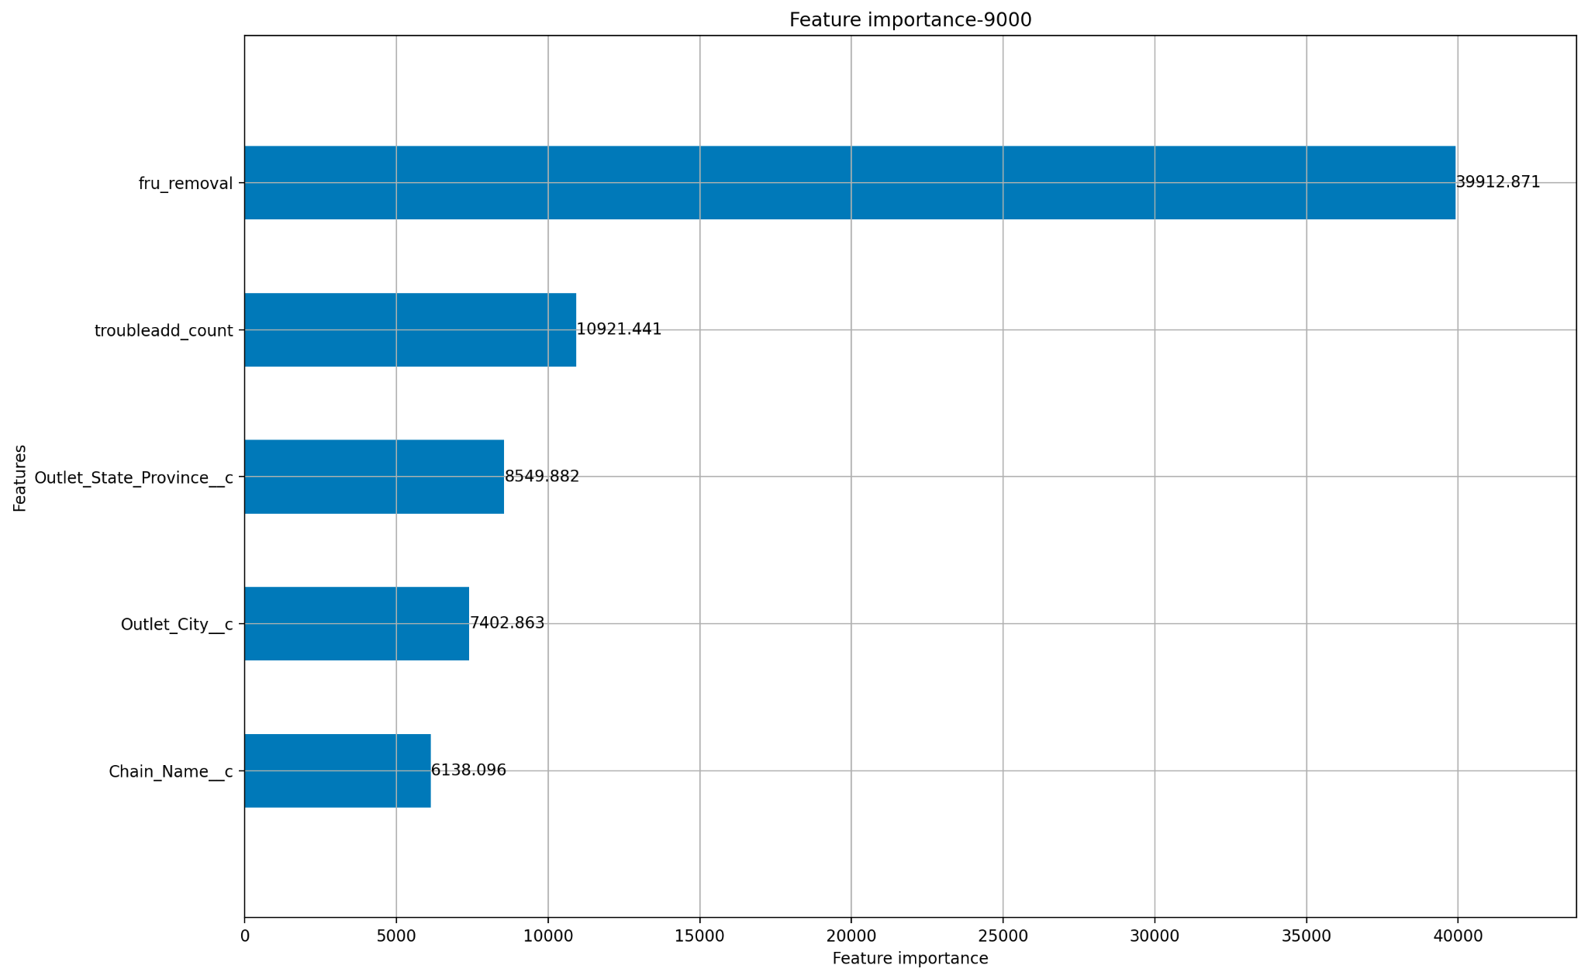
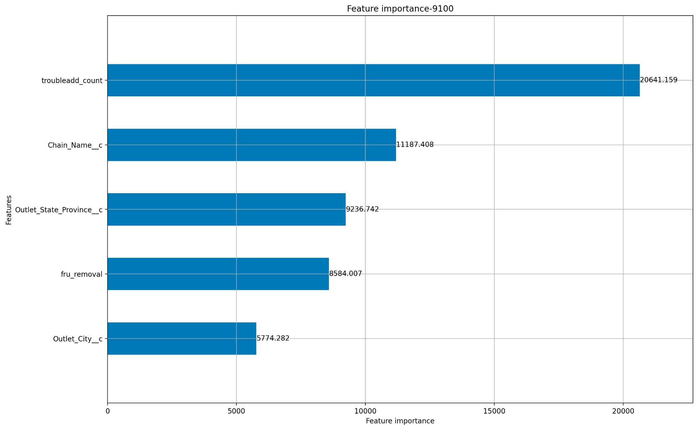
Model 2 Dipstick Test | ~40% Accuracy in predicting the annual cost bucket
What do we infer?
Data coming from sensors such as Trouble Count may be able to help us predict the cost of servicing better. More granular error data may help us predict the kind of resolution required and therefore the cost for servicing.
Trouble Add count & Part Removal impact the service costs more than other factors such as City, Outlet, or State

Slide 14
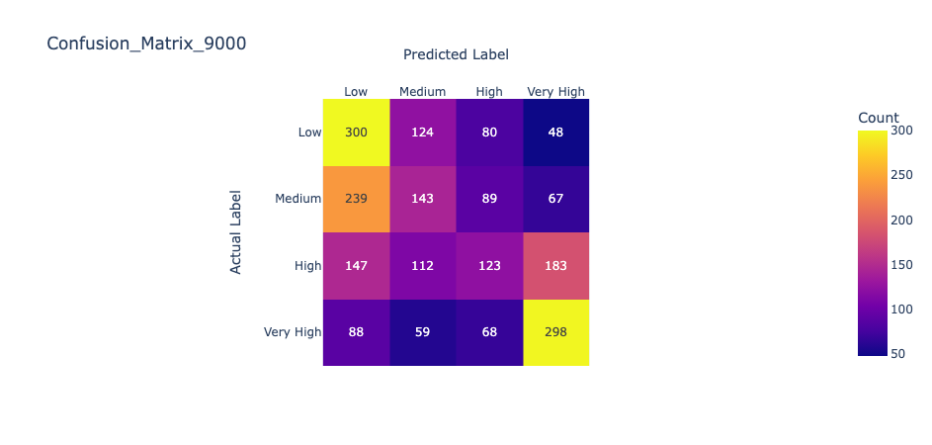
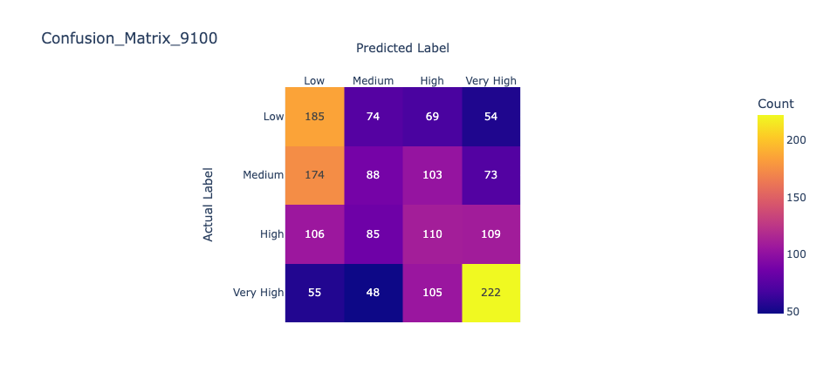
Model 2 Dipstick Test | ~40% Accuracy in predicting the annual cost bucket
What do we infer?
Data coming from sensors such as Trouble Count may be able to help us predict the cost of servicing better. More granular error data may help us predict the kind of resolution required and therefore the cost for servicing.
The performance improves significantly to 55% in predicting top and bottom quartiles (from earlier 35%)

Slide 15
What metrics can sensor data help us predict?
Is there a correlation between the sensor data leading to the service and the service cost?
Is there a correlation between service cost and number of hours involved spent for a service?
If yes, can sensor data help us predict the number of hours for a service?
Can we predict the service reason based on sensor data leading upto the date of service?
** We are using data at individual dispenser level

Slide 16
What metrics can sensor data help us predict?
Predicting cost at work-order level
Predicting cost bucket for a work-order
Output
Service Cost
Hours Spent in a service
Reason for Service
Input
The data we use to train models is at individual dispenser level. We will study data from all sensors and try to predict service cost or one of the input metrics for service cost based on that.

Slide 17
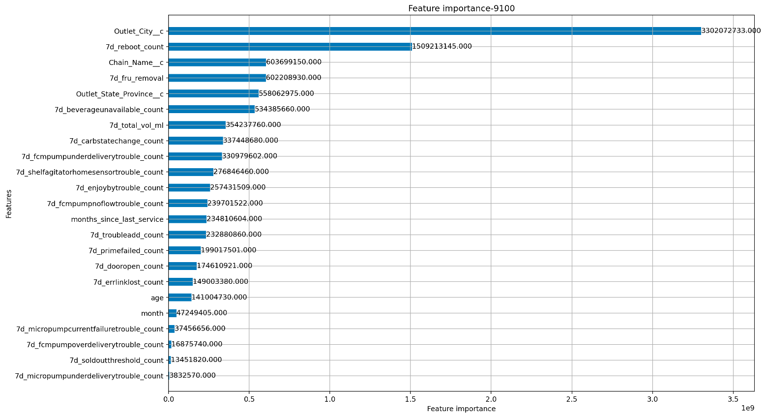
Sensor data correlation with service cost
S9100 | Sensor data improves error by 29% | Reboot count most important
LGBM Model
Error: $250 (down from $350)
But still poor!
R Squared: 0.076
Min Data in leaf: 20
Maximum Bins: 1000
Categorical Data Handling Enabled
Top 5 sensor points -
Reboot Count
Beverage Unavailable Count
Total Volume
Carb State Change
FCM Pump under delivery
Also signalling their correlation with a dispenser requiring service

Slide 18
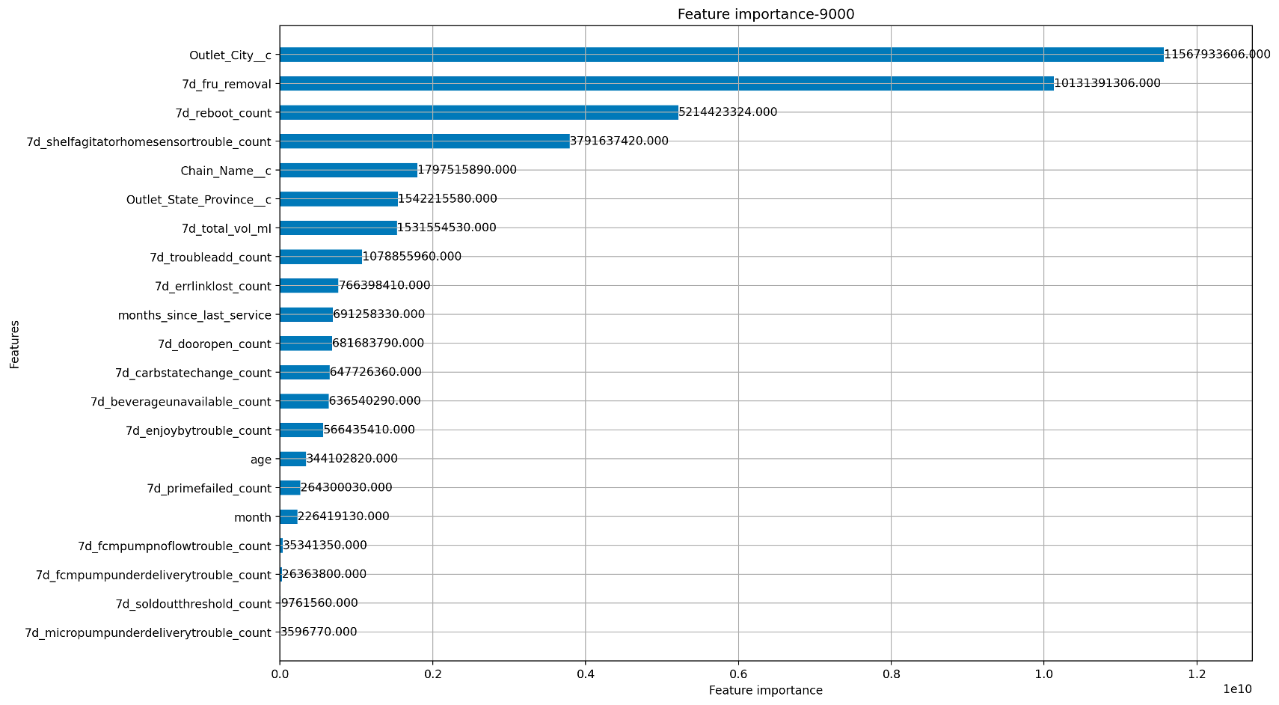
Sensor data correlation with service cost
S9000 | No improvement in error | Reboot count most important
LGBM Model
Error: $360
R Squared: 0.13
Min Data in leaf: 20
Maximum Bins: 1000
Categorical Data Handling Enabled
Top 5 sensor points -
Reboot Count
Shelf Agitator Home Sensor
Total Volume
Trouble Add
Error Link Lost
Also signalling their correlation with a dispenser requiring service

Slide 19
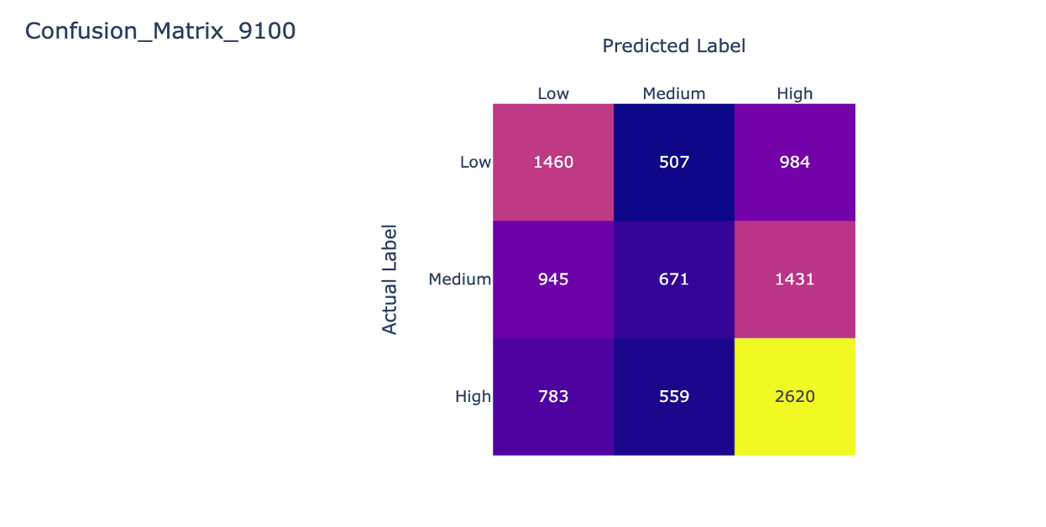
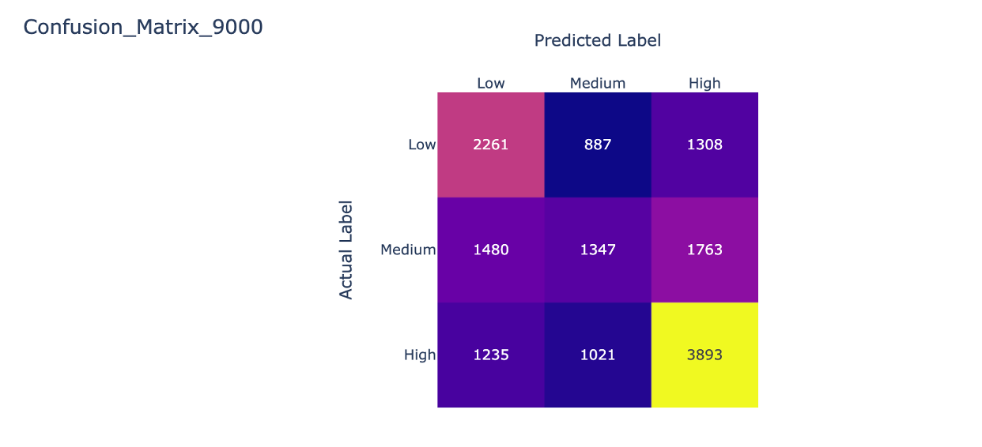
Sensor data correlation with service cost
~48% accuracy in predicting the cost bucket of a service
Sensor data helps us improve the model performance for Low (Bottom 30 percentile) and High (Top 40 percentile) Cost Buckets, but the prediction accuracy falls below 20% for the Medium Cost bucket.
Also, the parts related sensor data, significant for each dispenser type, seems to be different from each other i.e. Carb State and FCM pump for S9100 but Shelf Agitator for S9000
9100
9000

Slide 20
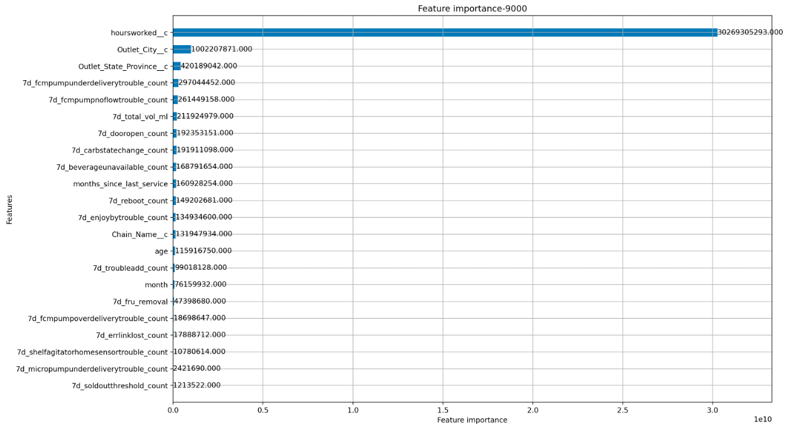
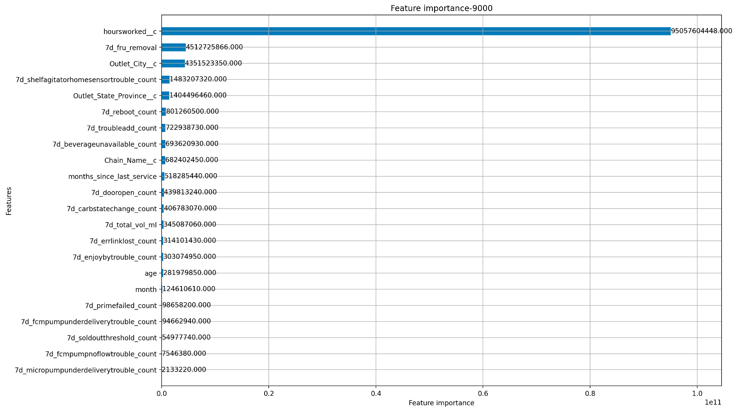
Hours Spent correlation with Service Cost
Hours spent in service supersede all other input variables
Total service cost is very highly dependent on total hour spent for service. This may be because of hourly service rates and the need for higher hours for certain issues.

Slide 21
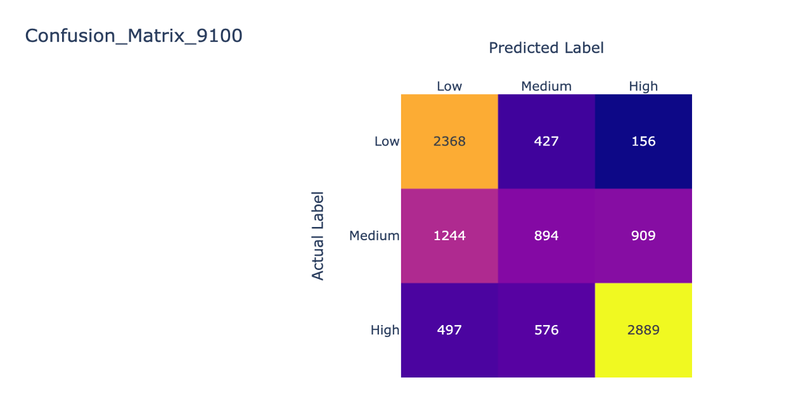
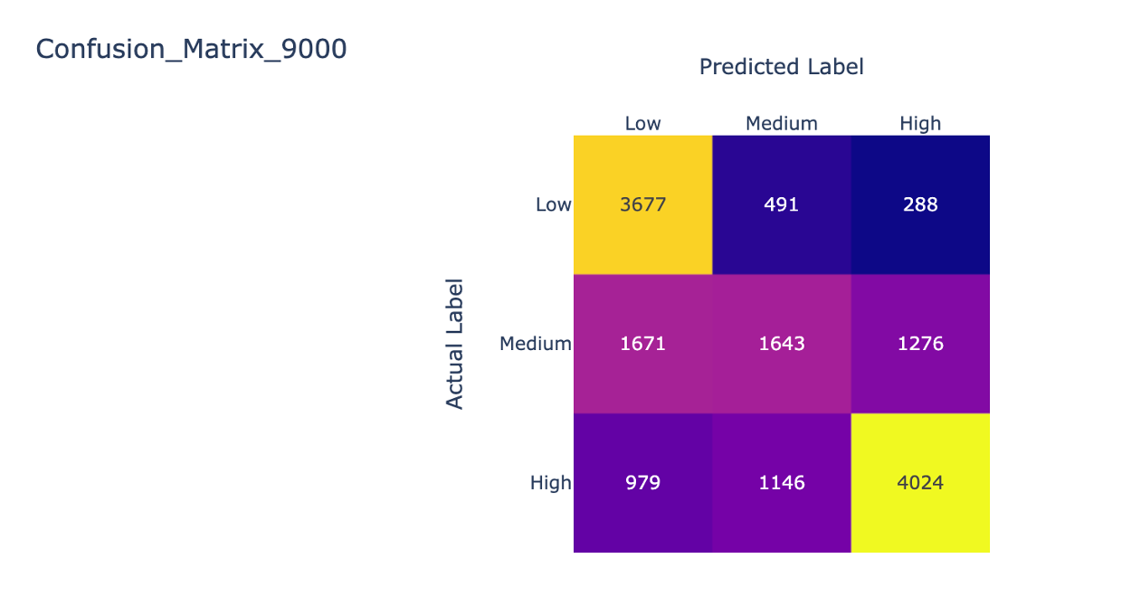
Hours Spent correlation with Service Cost
60% accuracy on including ‘hours spent’ in the model
But hours spent is an output metric! Can we know the hours spent before the service happens?
Hours spent can have multiple sources of noise such as technician proficiency and service provider, among others

Slide 22
Sensor data correlation with Hours Spent
Catboost model | Failed to predict Hours or Cost based on sensor data (At individual dispenser level)
Model | Target - Variable | Test RMSE | Test R- squared
CatBoost | Cost | 249.3 | 0.084
CatBoost | Hour | 1.12 | 0.094
So,
Sensor data is unable to improve model performance in predicting the cost of service
But we can predict the service cost bucket (especially Top 40 Percentile & Bottom 30 Percentile)
We know that the service cost is directly related to the number of hours spent in service.
But sensor data does not help predict the number of hours spent

Slide 23
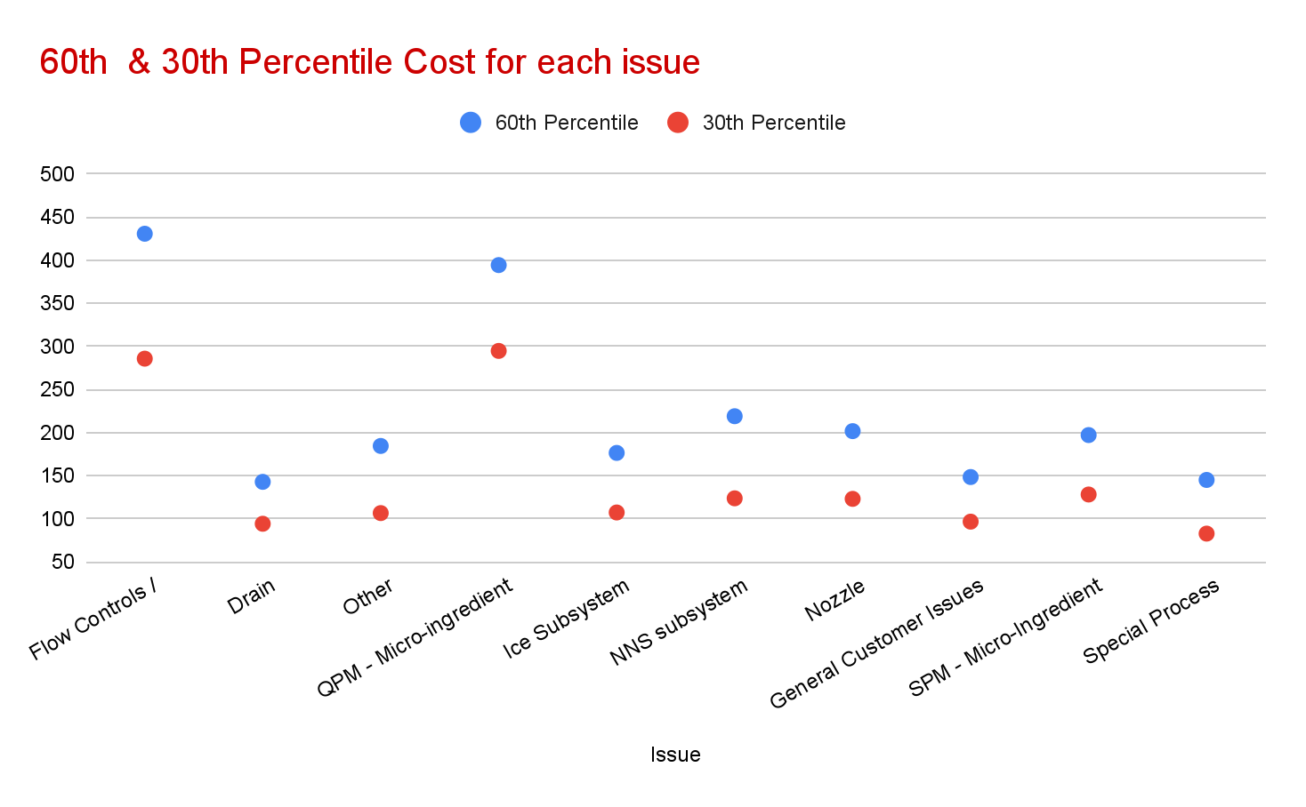
Sensor data correlation with Service Reason
Flow Control and CPM issues seem to have the highest service cost
However, NO correlation was found between the service reason and the hours spent during the service

Slide 24
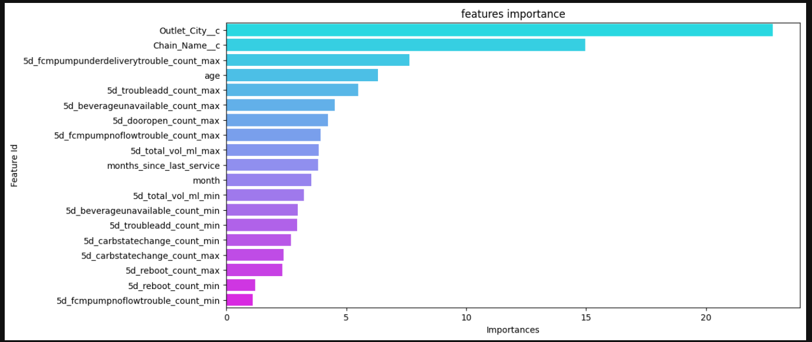
Sensor data correlation with Service Reason
Sensors’ max. count shows higher importance in predicting service reason

Slide 25
Sensor data correlation with Service Reason
36% accuracy in predicting the service reason - based on sensor data
Service Reason | precision | recall | f1-score | support
Drain | 0.27 | 0.56 | 0.37 | 1110
Flow Controls / ECM/Module | 0.49 | 0.67 | 0.57 | 1551
General Customer Issues | 0.16 | 0.04 | 0.06 | 526
General Electrical | 0.28 | 0.1 | 0.15 | 358
Ice Subsystem | 0.19 | 0.01 | 0.02 | 443
NN5 subsystem | 0.28 | 0.15 | 0.2 | 522
Nozzle | 0.21 | 0.04 | 0.07 | 444
other | 0.29 | 0.21 | 0.25 | 939
SPM - Micro-Ingredient | 0.37 | 0.52 | 0.43 | 1088
Special Process | 0.37 | 0.09 | 0.15 | 347
So,
We are unable to predict the service reason based on sensor data leading to the service.

Slide 26
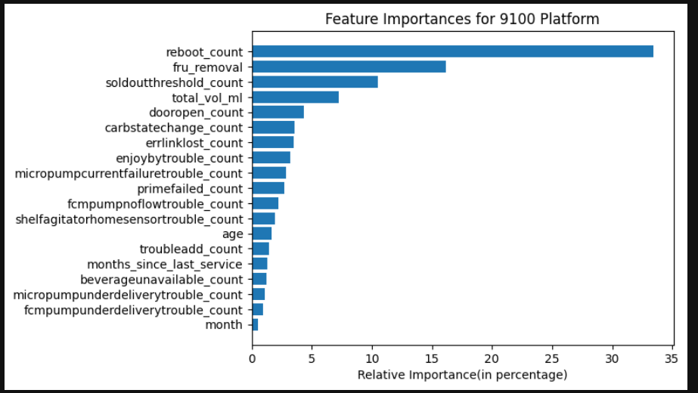
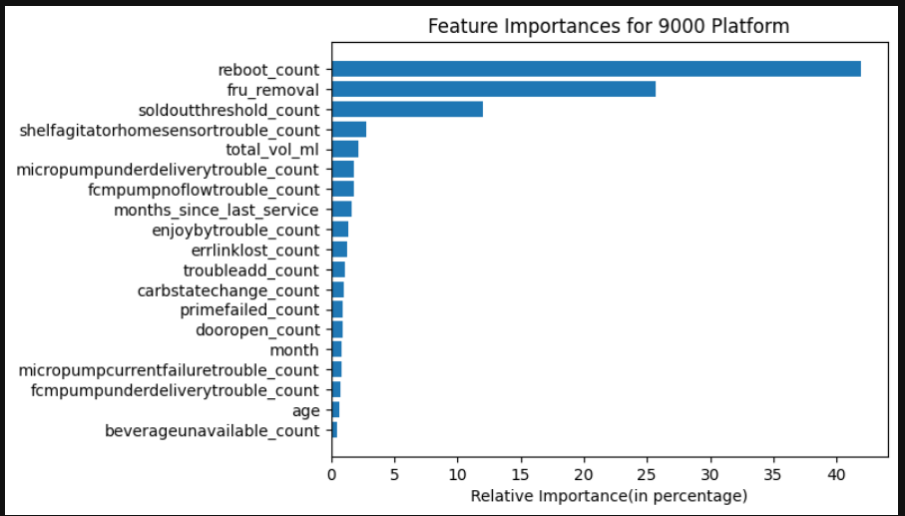
Significantly better performance on rolling up the output metric to daily cost
Why predict the daily cost?
We are unable to predict the service reason, hours spent, or cost per service. And therefore, we tried reducing the granularity of the model to predict Daily Service Cost per active dispenser. The Mean Absolute Percentage Error is ~15%.
The significance of specific sensor’s remains in line with what we observed earlier - Link

Slide 27
Model Parameters - Significant improvement from per service cost models
Parameter | S9000 | S9100
Root Mean Squared Error | 0.44 | 0.39
R-Squared | 0.62 | 0.39
MAPE | 0.15 | 0.19
Mean | 2.26 | 1.71
Standard Deviation | 0.75 | 0.52
The model analysed same day sensor data to come up with daily service cost per active dispenser. The results were not better when we tried to use T-1 or T-2 data points. In fact, the performance of the model deteriorated a bit.
This means either -
The time lag between sensor data and service is less than a day, or
Irrespective of day, the data of all sensors combined remains constant over a period of time

Slide 28
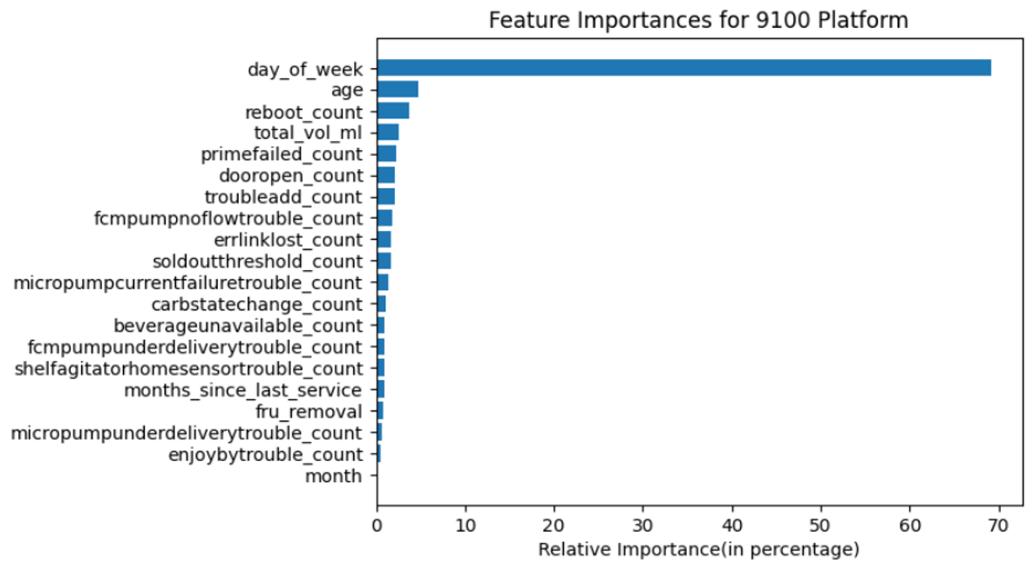
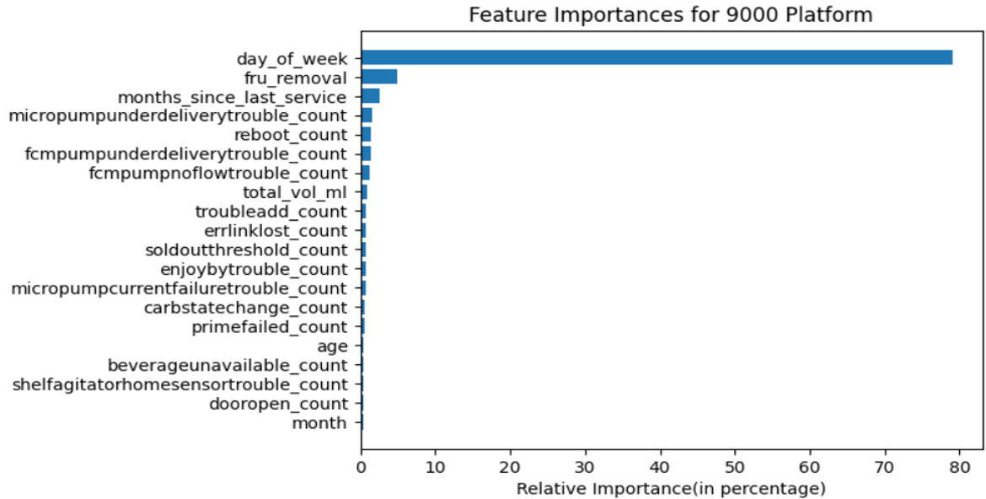
Daily Service cost has very high dependence on the day of the week
Why check dependence on day of the week?
The distribution of servicing cost is thin peaked! And therefore any factor that can help us move our predictions is worth investigating.
Day of the week shows up as far more important - Does that mean we don't need anything else? - NO

Slide 29
Weekends have ~3% lesser average cost compared to weekdays
Day | Average Total Cost | Average Parts Cost | # of services
Sunday | 282 | 117 | 8345
Monday | 295 | 132 | 20057
Tuesday | 292 | 128 | 18187
Wednesday | 294 | 129 | 17200
Thursday | 298 | 132 | 16675
Friday | 292 | 127 | 17195
Saturday | 277 | 112 | 11133
Parameter | S9000 | S9100
Root Mean Squared Error | 0.38 | 0.37
R-Squared | 0.71 | 0.48
MAPE | 0.13 | 0.18
We observe that the weekends have slightly lesser average servicing cost - Mostly driven by the cost of parts replaced. This may be an outcome of an logistical situation.
However, the model improves only by ~2% points and that’s because the standard deviation of average cost by weekday is ~$7.6 while the mean is ~$290, and therefore as stated on previous slide, a very thin peaked distribution.

Slide 30
Tree-Based Features: Minimal Impact on Service Cost Prediction
Why utilize Tree-based Features ?
Tree-based features leverage the decision paths of a decision tree model to create potentially informative input variables for another model. This technique aims to capture complex relationships in the data that might improve predictive accuracy
Illustration of a Decision Tree: Leaf nodes (highlighted) represent decision outcomes used as features in the subsequent model. Both highly accurate and less accurate leaf conditions are incorporated to capture a range of predictive signals

Slide 31
Limited Impact of Lagged Sensor Data on Daily Service Cost Prediction
Why utilize Lagged Features ?
To investigate the correlation between recent historical sensor data and service cost estimation. Part replacement data for the same day was also incorporated. The Mean Absolute Percentage Error (MAPE) in predicting Daily Service Cost per active dispenser showed minimal change with these additional factors.
Performance Metrics Comparison: S9000 vs S9100 Models
Parameter | S9000 | S9100
Root Mean Squared Error | 0.43 | 0.38
R-Squared | 0.62 | 0.39
MAPE | 0.15 | 0.19
Mean | 2.26 | 1.71
Standard Deviation | 0.75 | 0.52

Slide 32
Best Iteration : Model predicting ‘Daily Service Cost per active dispenser’
What Features were used ?
Sensor Count for that day
Month
Age
Part Removal quantity for that day
Top Predictor Variables
Reboot Count
Parts Removal data
Sold-out-threshold Count
Total Volume
Accuracy Values Observed ?
S9000: 85 %
S9100: 81 %

